Slide 1
CompTIA A+ Certification 801 Support Skills
Unit 1.2 Motherboard Components

Slide 2
Identify different case types and how to access system components
Distinguish ATX, ITX, and proprietary motherboard form factors
Identify components of the motherboard and describe the functions of the chipset
Unit 1.2 Motherboard Components
Slide <number>

Slide 3
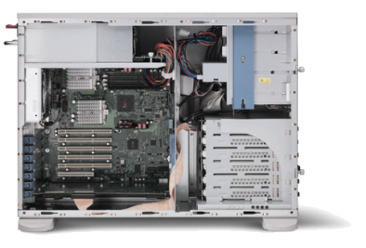
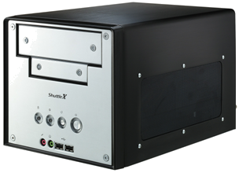
System Case Types
Desktop
  Standard
  Slimline
Tower
  Full
  Midi
  Mini
Small Form Factor
Unit 1.2 Motherboard Components
Slide <number>

Slide 4
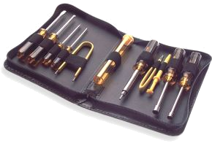
Disassembling a PC
Field Replaceable Units (FRU)
Backup
Clean work environment
Tools and equipment
  PC toolkit
  Notepad and pen
  Digicam
Power off devices and remove cables
Take ESD precautions
Unit 1.2 Motherboard Components
Slide <number>

Slide 5
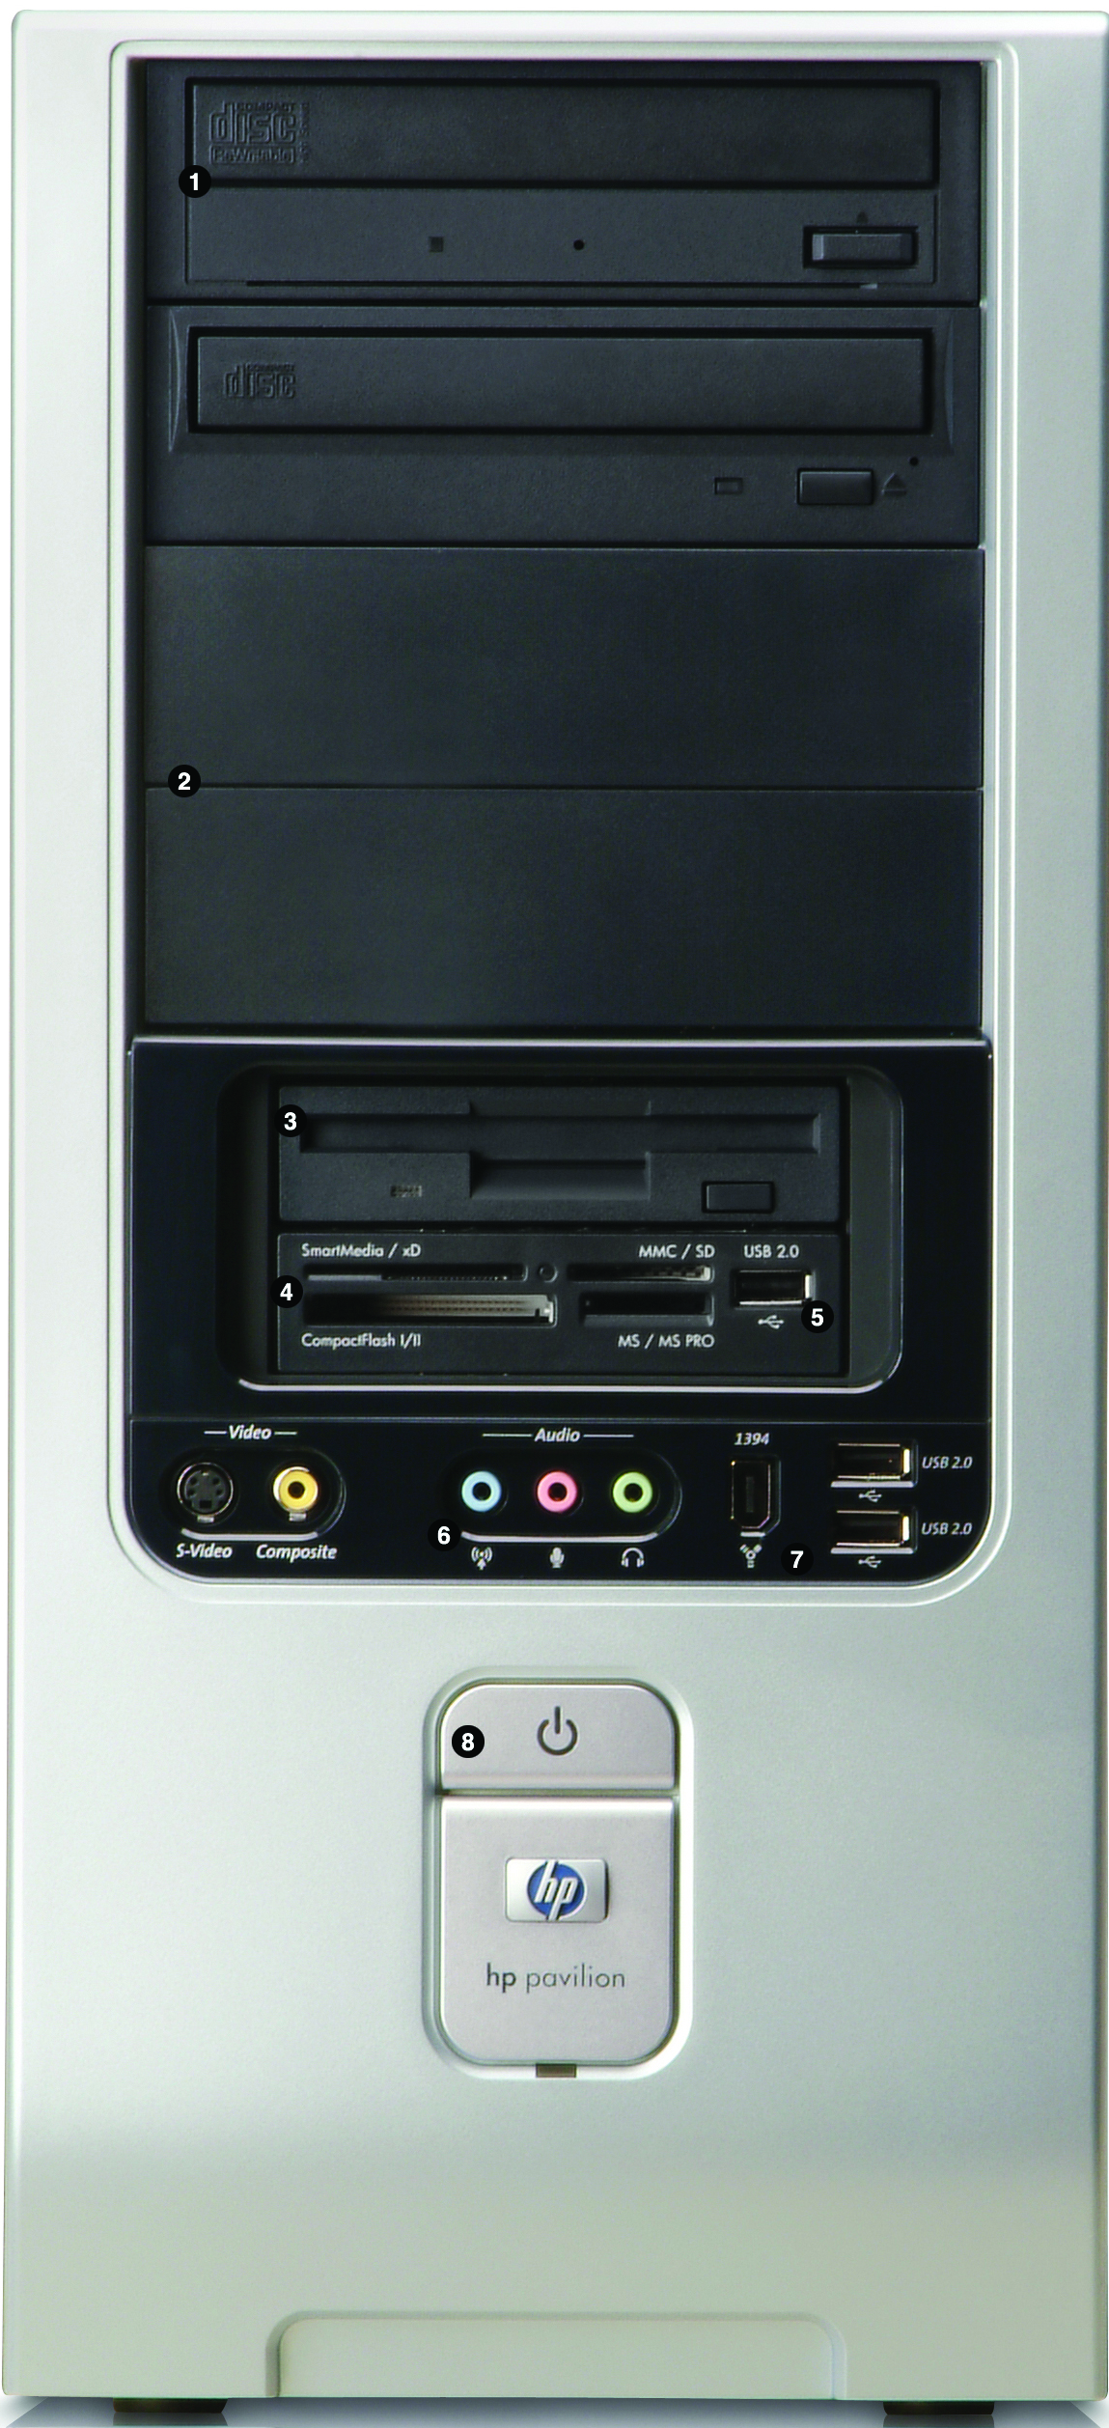
Front Panel
Drive bays
Ports (USB / Firewire / Audio/Video)
Power switch
Status LEDs
Usually need to remove side panel to access the clips holding the front panel bezel in place
Unit 1.2 Motherboard Components
Slide <number>

Slide 6
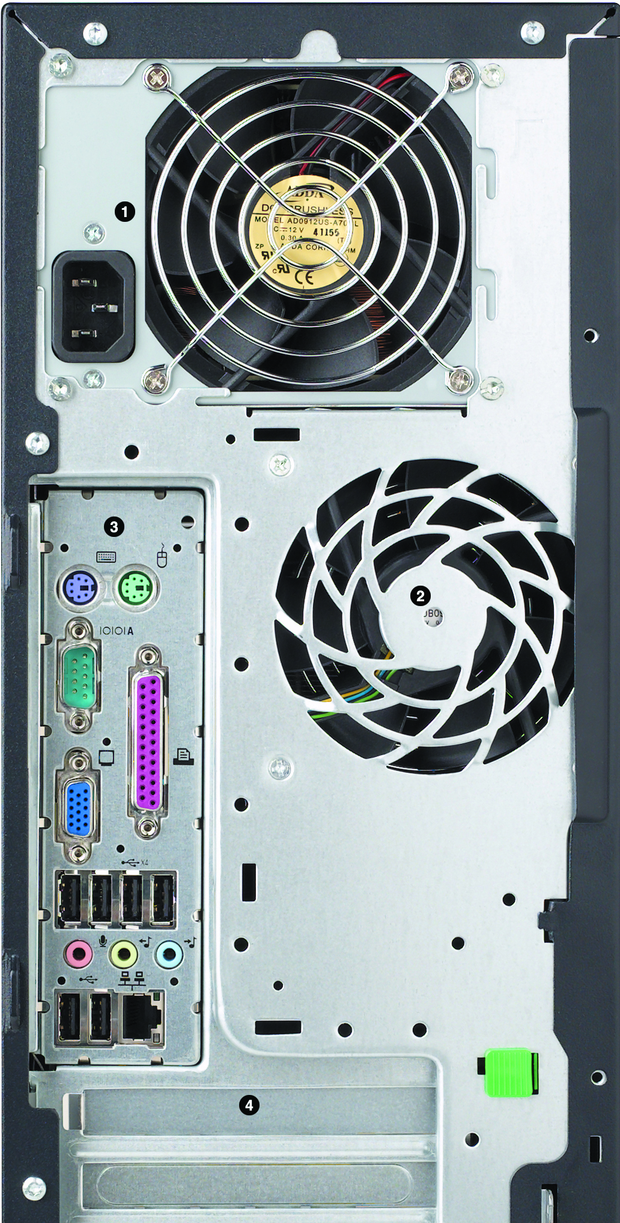
Rear Panel
Power connector
Fan exhausts
Ports
Expansion card slots
Unit 1.2 Motherboard Components
Slide <number>

Slide 7
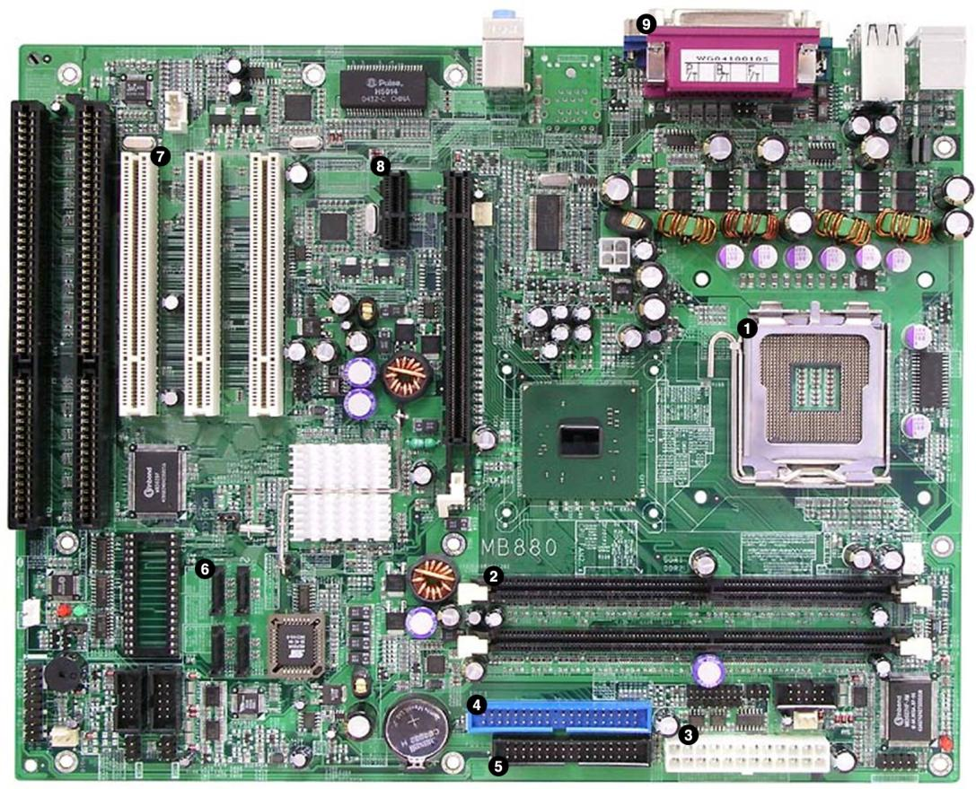
Motherboard Layout
Unit 1.2 Motherboard Components
Slide <number>

Slide 8
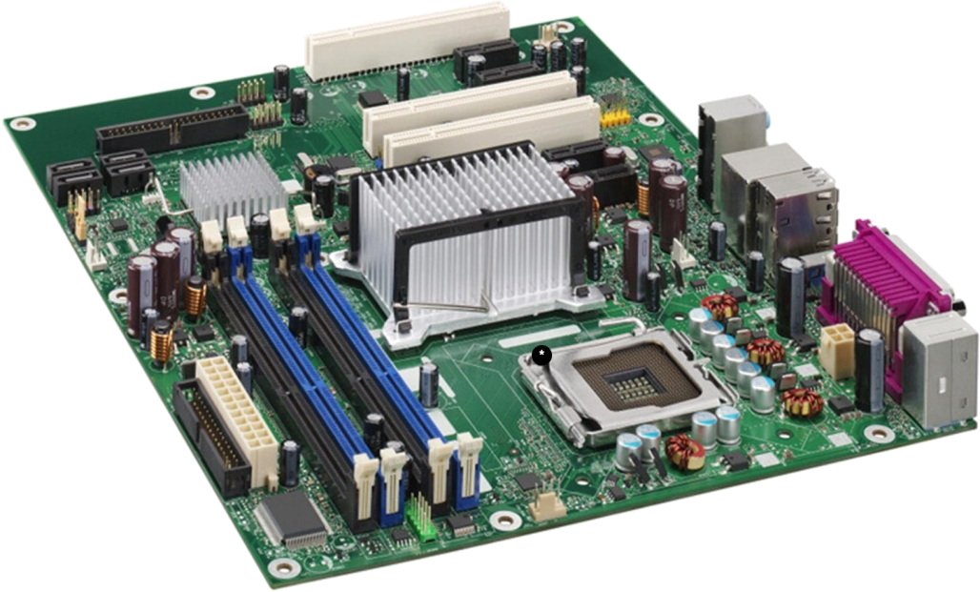
Motherboard Form Factors
Determines shape, physical layout, and the type of case and power supply that can be used
Mounting holes / standoffs
ATX
  12”x9.6”
  7 adapter card slots
Micro-ATX
  9.6” square
  4 slots
Small Form Factor
  Mini-ITX (1 slot)
  Proprietary designs
Unit 1.2 Motherboard Components
Slide <number>

Slide 9
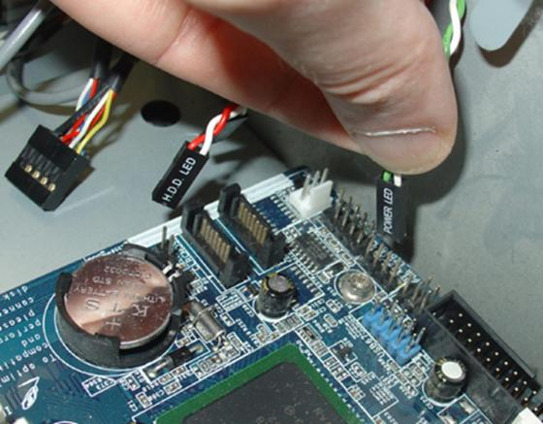
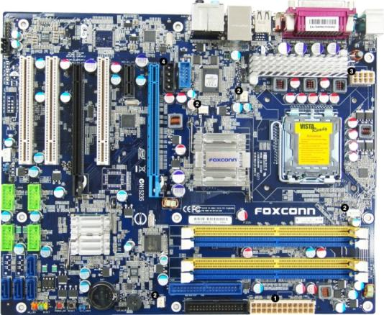
Motherboard Headers
Front panel connectors
  Power
  HDD
  USB
  Audio
  Make a note of how these are connected!
Jumpers
Power and fan connectors
Unit 1.2 Motherboard Components
Slide <number>

Slide 10
Bus Architecture
Data bus width (64-bit)
Address bus (memory locations)
Internal bus (CPU > Memory, Chipset, ([Graphics Adapter])
External bus (storage, adapter cards, peripherals)
Timing (system clock)
Parallel and serial bus types
Unit 1.2 Motherboard Components
Slide <number>

Slide 11
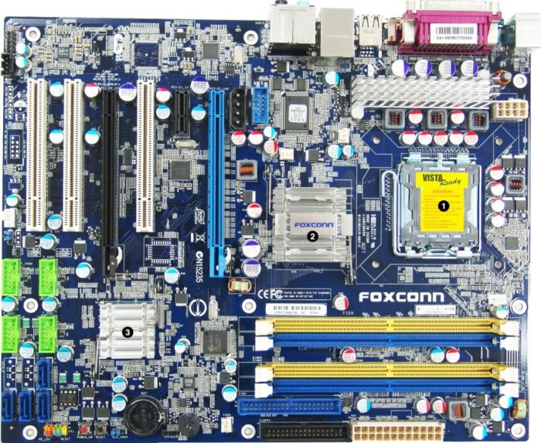
CPU Socket and Chipset
Compatibility
  Type of processor, processor speed, and multiprocessing support
  Type and amount of system memory supported
  Type of power management supported
  Type(s) of system bus supported
Controllers
  System memory controller
  A keyboard and PS/2 mouse controller
  An Input / Output (I/O) controller that handles serial ports, parallel ports, floppy disks, disk drives, and expansion buses
  Controllers for any integrated video, sound, network (cabled and wireless), and SCSI interfaces
Unit 1.2 Motherboard Components
Slide <number>

Slide 12
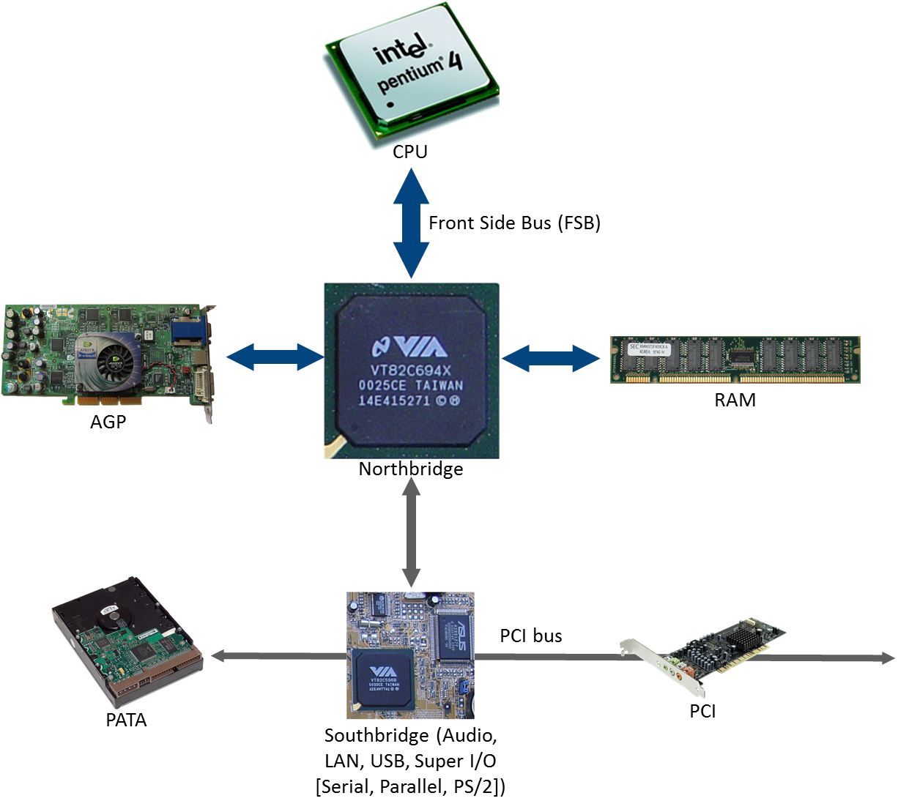
Northbridge / Southbridge
Unit 1.2 Motherboard Components
Slide <number>

Slide 13
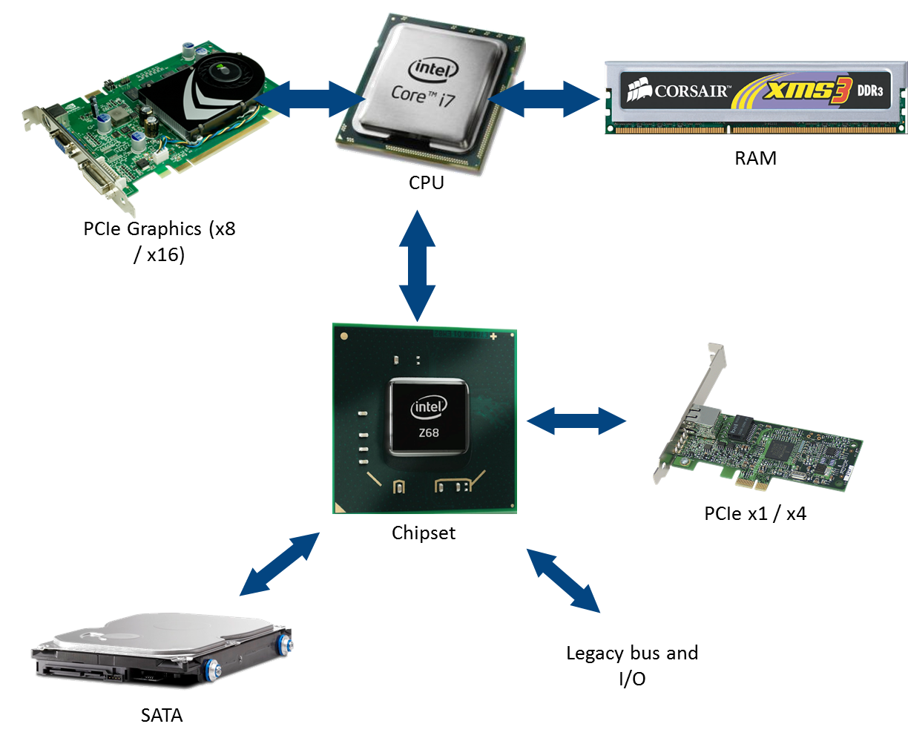
Modern Chipsets
Unit 1.2 Motherboard Components
Slide <number>

Slide 14
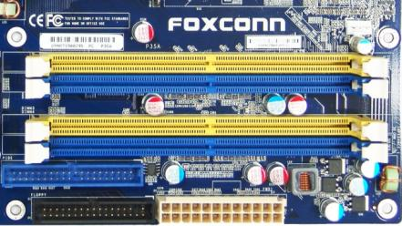
Memory
System memory
  Random Access Memory (RAM)
  Provides fast access to program data for CPU
  Volatile – data does not persist without power
  DIMM slots
  Compatible with speed and type
Unit 1.2 Motherboard Components
Slide <number>

Slide 15
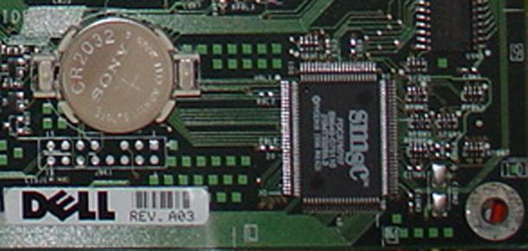
ROM BIOS and CMOS RAM
Read Only Memory (ROM) can preserve data without power
Basic Input / Output System is the PC firmware that enables it to boot
Firmware is persistent software and is only changed infrequently
Complementary Metal-Oxide Semiconductor RAM stores variable CMOS settings – it is powered by a battery
Unit 1.2 Motherboard Components
Slide <number>

Slide 16
Identify different case types and how to access system components
Distinguish ATX, ITX, and proprietary motherboard form factors
Identify components of the motherboard and describe the functions of the chipset
Unit 1.2 Motherboard Components
Slide <number>

